Slide 1
Jovac Project
Submitted By-
Team- The Analyst
JANVI GUPTA
(janvi.gupta_cs.aiml19@gla.ac.in)
DIVYANSH MISHRA
(divyansh.mishra_cs.aiml19@gla.ac.in)

Slide 2
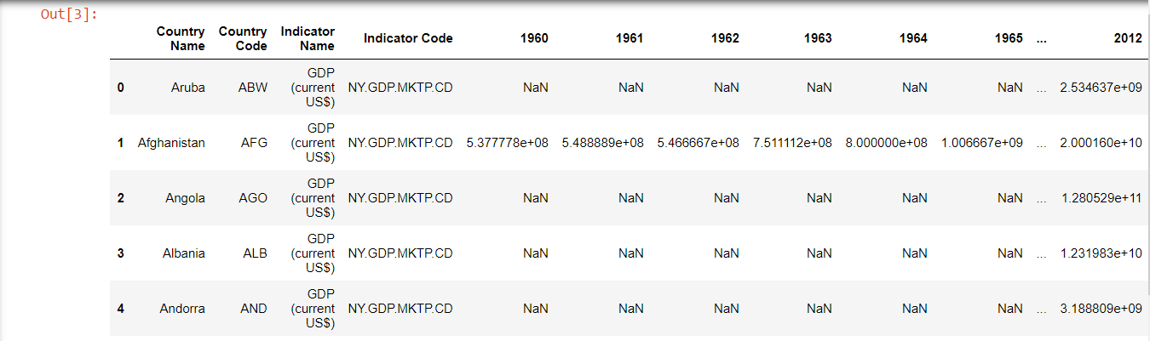
Data-Set
Link-https://www.kaggle.com/zackerym/gdp-annual-growth-for-each-country-1960-2020
Glimpse of the data-set

Slide 3
Acknowledgements
GDP at purchaser's prices is the sum of gross value added by all resident producers in the economy plus any product taxes and minus any subsidies not included in the value of the products. It is calculated without making deductions for depreciation of fabricated assets or for depletion and degradation of natural resources.
Data are in current U.S. dollars. Dollar figures for GDP are converted from domestic currencies using single year official exchange rates. For a few countries where the official exchange rate does not reflect the rate effectively applied to actual foreign exchange transactions, an alternative conversion factor is used.

Slide 4
Description to the Data-set
Our dataset contains GDP annual growth of different countries from year 1960 to 2019.
This dataset contains data about 264 countries. There is some missing data for several countries. Format of data: .csv
Column names and description:
"Country Name" - name of country
"Country Code" - code of country (3 letters)
"Indicator Name" - all fields filled with 'GDP (current US$)'
"Indicator Code" - all fields contains 'NY.GDP.MKTP.CD' value
Columns for each year (1960 - 2020)

Slide 5
Task List
Exploratory Data Analysis(EDA)
Data Visualization
Prediction Model
Conclusion

Slide 6
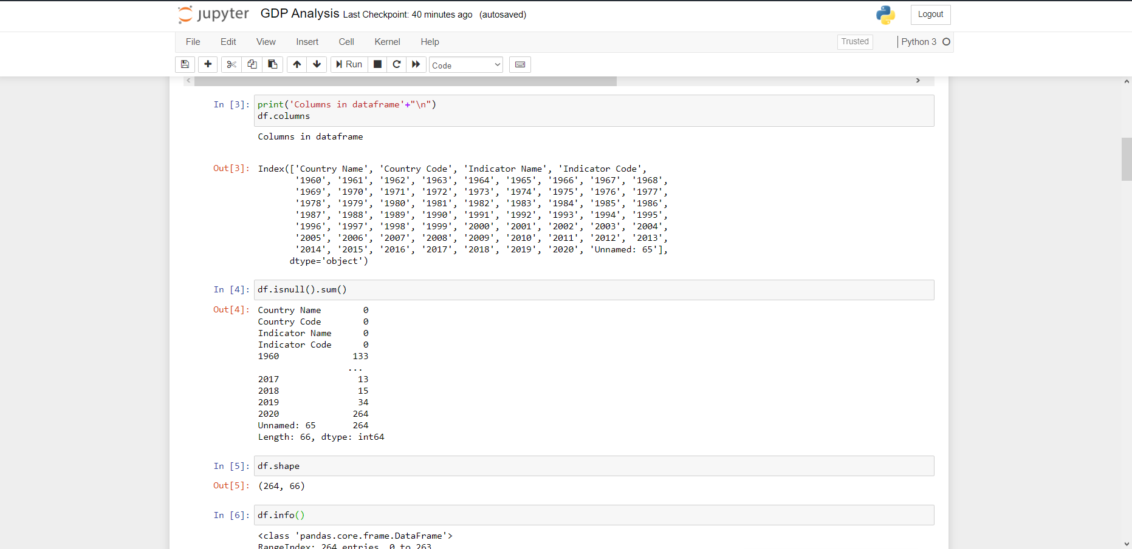
Exploratory Data Analysis

Slide 7

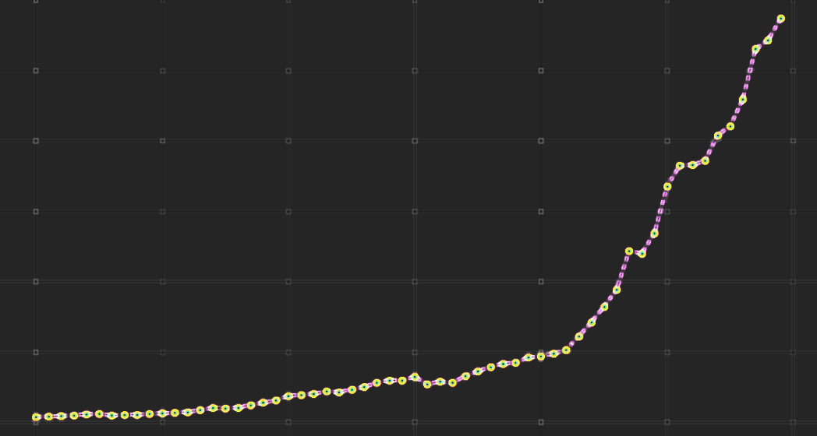
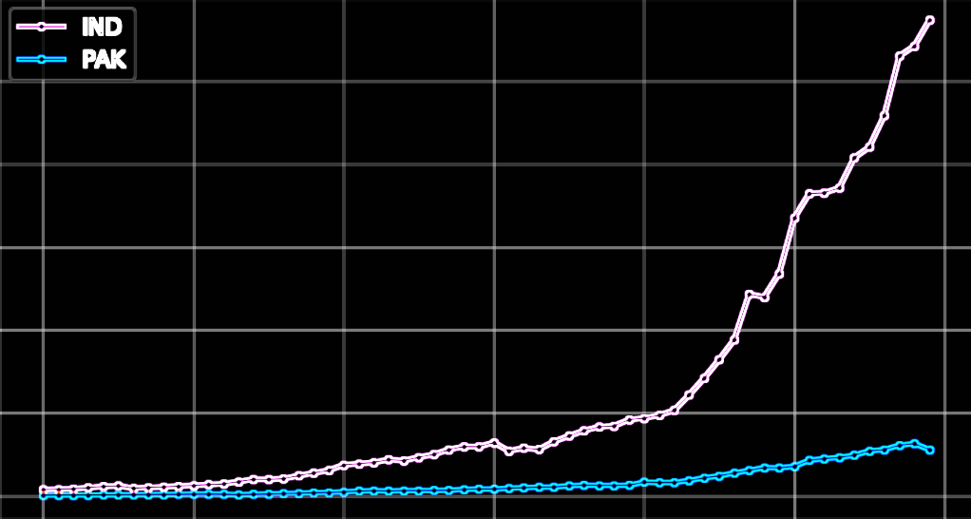
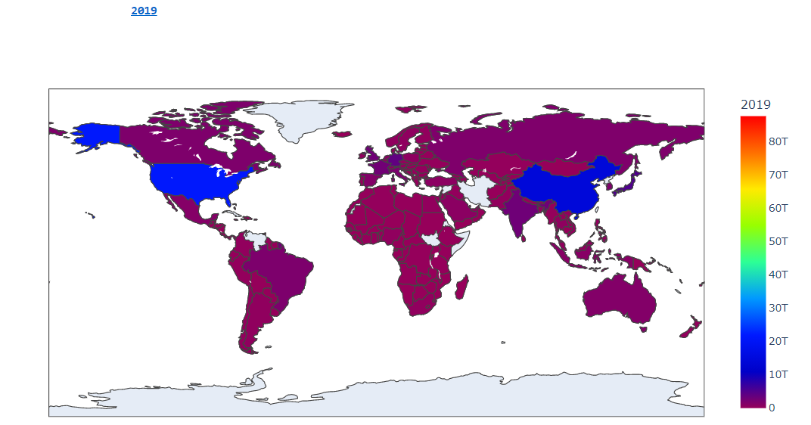
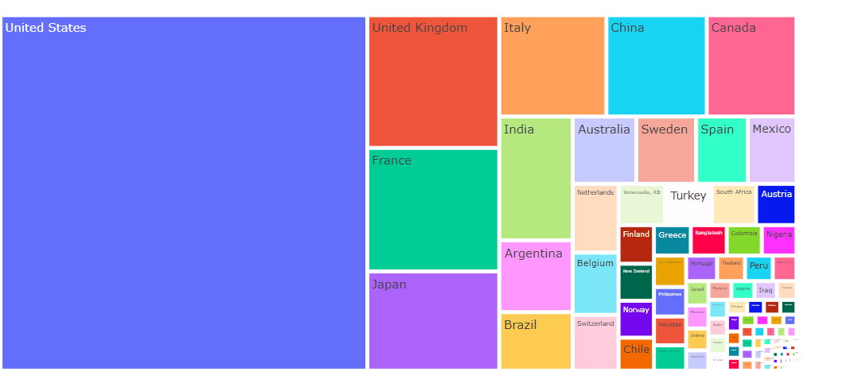
Data Visualization
INDIA GDP SCORE(1960-2019)
IND VS PAK GDP SCORE
WORLD GDP 2019
TOP GDP SCORE EACH YEAR

Slide 8
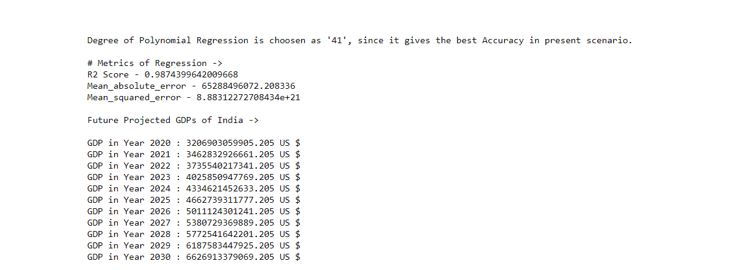
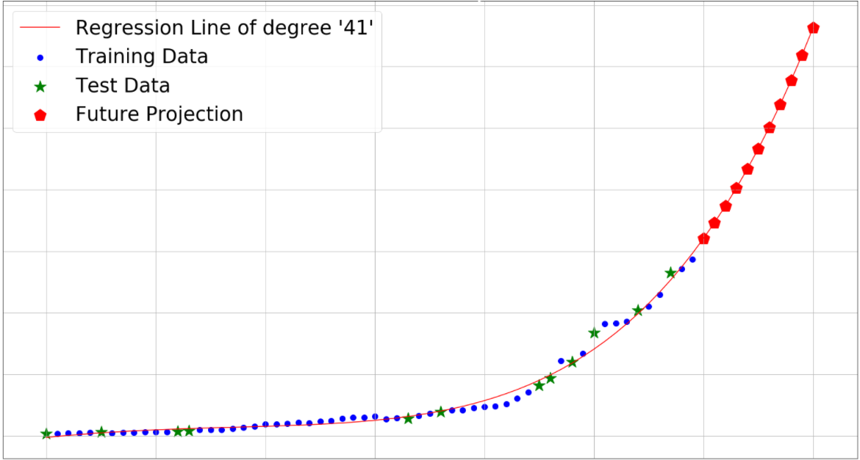
Prediction Model

Slide 9
Conclusion
We can conclude from the graphs that GDP Score of each country in increasing per year.
From the tree map of each year we can conclude that United States have been at the Top in GDP Score from year 1960-2019.
Particularly talking of India, we can see from the prediction score that their are high predictions of gradually raise in the GDP Score of India in the Future.

Slide 10
Thank You

